Slide 1


Slide 2
Oscillations

Slide 3
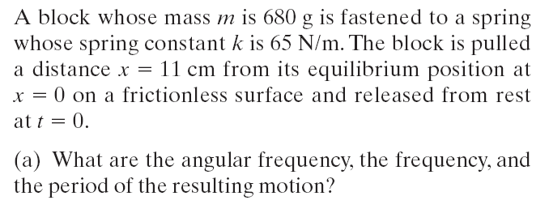
Example

Slide 4
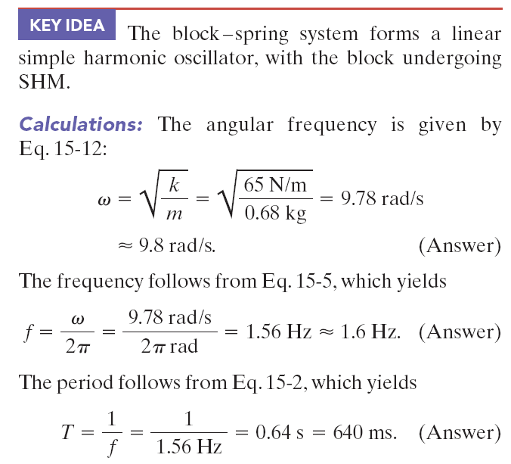

Slide 5
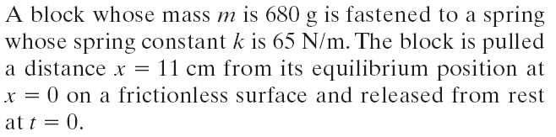
Example

Slide 6
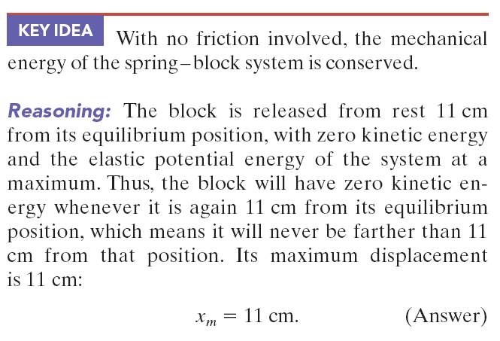

Slide 7
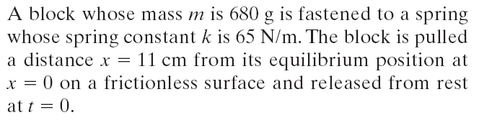

Example

Slide 8

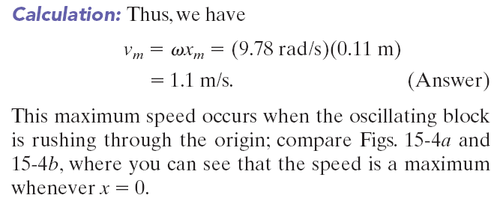

Slide 9
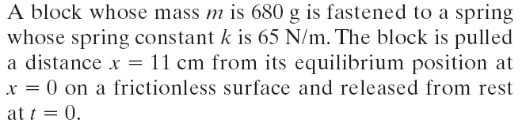

Example

Slide 10
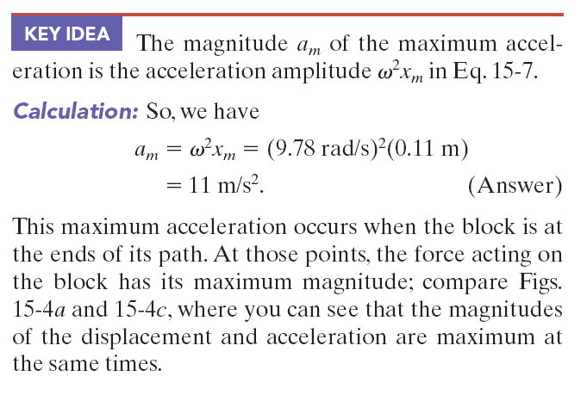

Slide 11
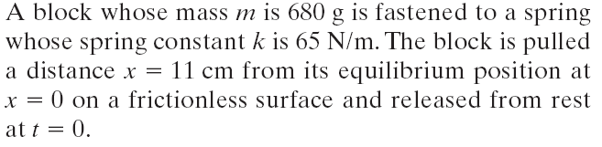
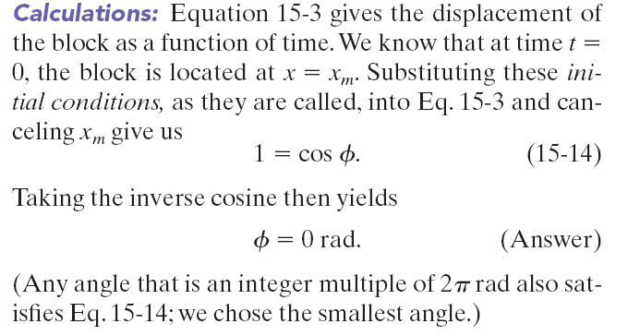
Example

Slide 12
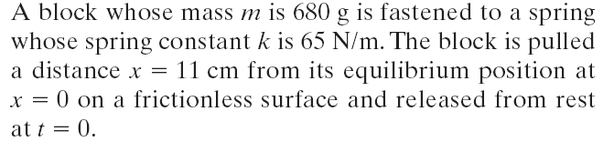

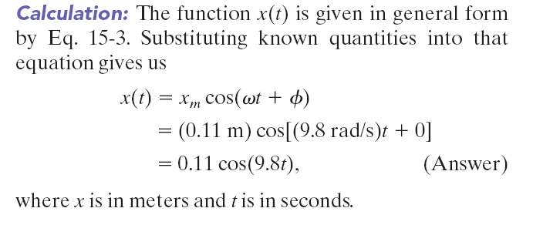
Example :

Slide 13

Example, energy in SHM:
Many tall building have mass dampers, which are anti-sway devices to prevent them from oscillating in a wind. The device might be a block oscillating at the end of a spring and on a lubricated track. If the building sways, say eastward, the block also moves eastward but delayed enough so that when it finally moves, the building is then moving back westward. Thus, the motion of the oscillator is out of step with the motion of the building.
Suppose that the block has mass m = 2.72 x 10⁵ kg and is designed to oscillate at frequency f = 10.0 Hz and with amplitude x_{m} = 20.0 cm.
(a) What is the total mechanical energy E of the spring-block system?

Slide 14
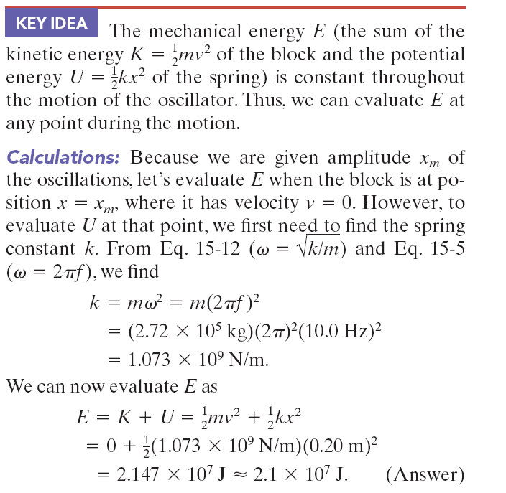
Example, energy in SHM:

Slide 15
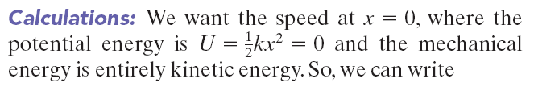
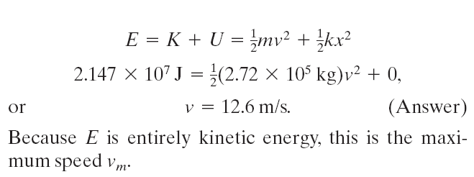
Example, energy, continued:

Slide 16
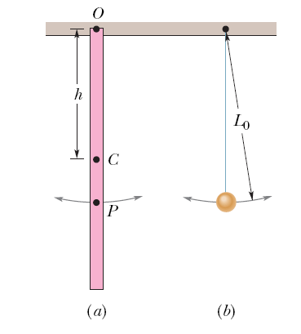
Example, pendulum:
In Fig. a, a meter stick swings about a pivot point at one end, at distance h from the stick’s center of mass.
What is the period of oscillation T?
What is the distance L₀ between the pivot point O of the stick and the center of oscillation of the stick?
Note the result is independent of the pendulum’s mass m.

Slide 17




Example, pendulum:
In Fig. a, a meter stick swings about a pivot point at one end, at distance h from the stick’s center of mass.
What is the period of oscillation T?
KEY IDEA: The stick is not a simple pendulum because
its mass is not concentrated in a bob at the end opposite
the pivot point—so the stick is a physical pendulum.
Calculations: The period for a physical pendulum depends on the rotational inertia, I, of the stick about the pivot point. We can treat the stick as a uniform rod of length L and mass m. Then I =1/3 mL², where the distance h is L.
Therefore,
Note the result is independent of the pendulum’s mass m.

Slide 18


Example, pendulum, continued:
(b) What is the distance L₀ between the pivot point O of the stick and the center of oscillation of the stick?
Calculations: We want the length L₀ of the simple pendulum (drawn in Fig. b) that has the same period as the physical pendulum (the stick) of Fig. a.

Slide 19

A particle rotates counterclockwise in a circle of radius 3.00 m with a constant angular speed of 8.00 rad/s. At , the particle has an x coordinate of 2.00 m and is moving to the right.
(a) Determine the x coordinate as a function of time.
(b) Find the x component of particle’s velocity and acceleration at any time ‘t’.

Slide 20
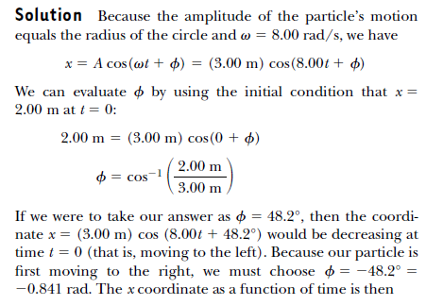
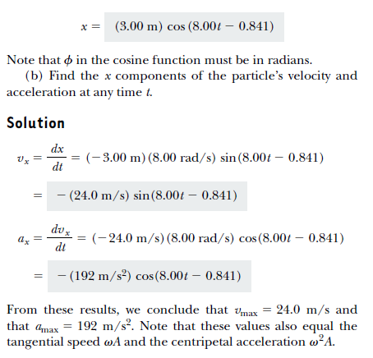
A particle rotates counterclockwise in a circle of radius
3.00 m with a constant angular speed of 8.00 rad/s. At ,
the particle has an x coordinate of 2.00 m and is moving to
the right. (a) Determine the x coordinate as a function of
time.

Slide 21
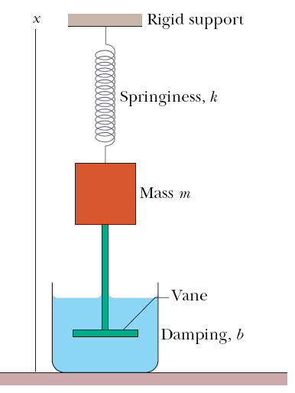
Example :
For the damped oscillator in the figure, m 250 g, k = 85 N/m, and
b =70 g/s.
What is the period of the motion?
How long does it take for the amplitude of the damped oscillations to drop to half its initial value?
How long does it take for the mechanical energy to drop to one-half its initial value?

Slide 22
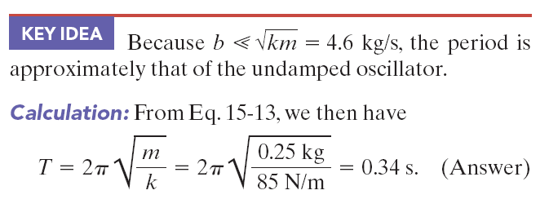
Example :
For the damped oscillator in the figure, m 250 g, k = 85 N/m, and b =70 g/s.
(a) What is the period of the motion?

Slide 23


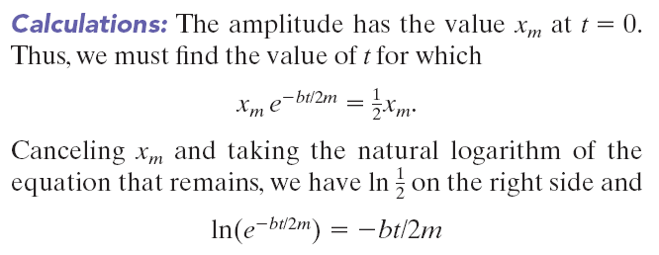
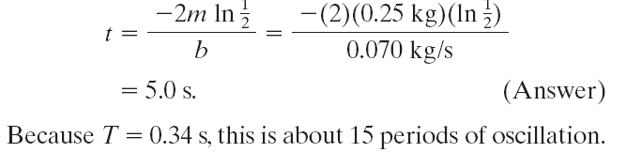
Example :
(b) How long does it take for the amplitude of the damped oscillations to drop to half its initial value?

Slide 24
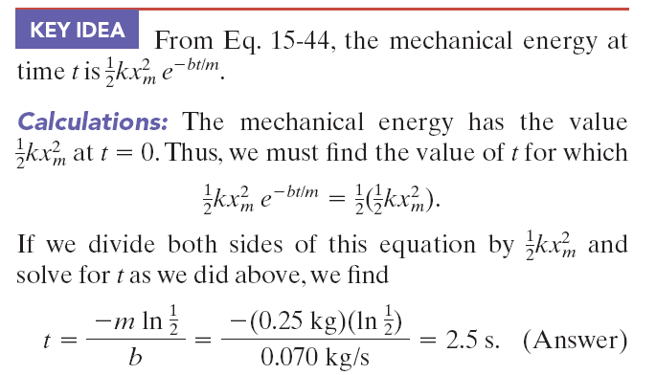
Example :
(c) How long does it take for the mechanical energy to drop to one-half its initial value?

